Slide 1


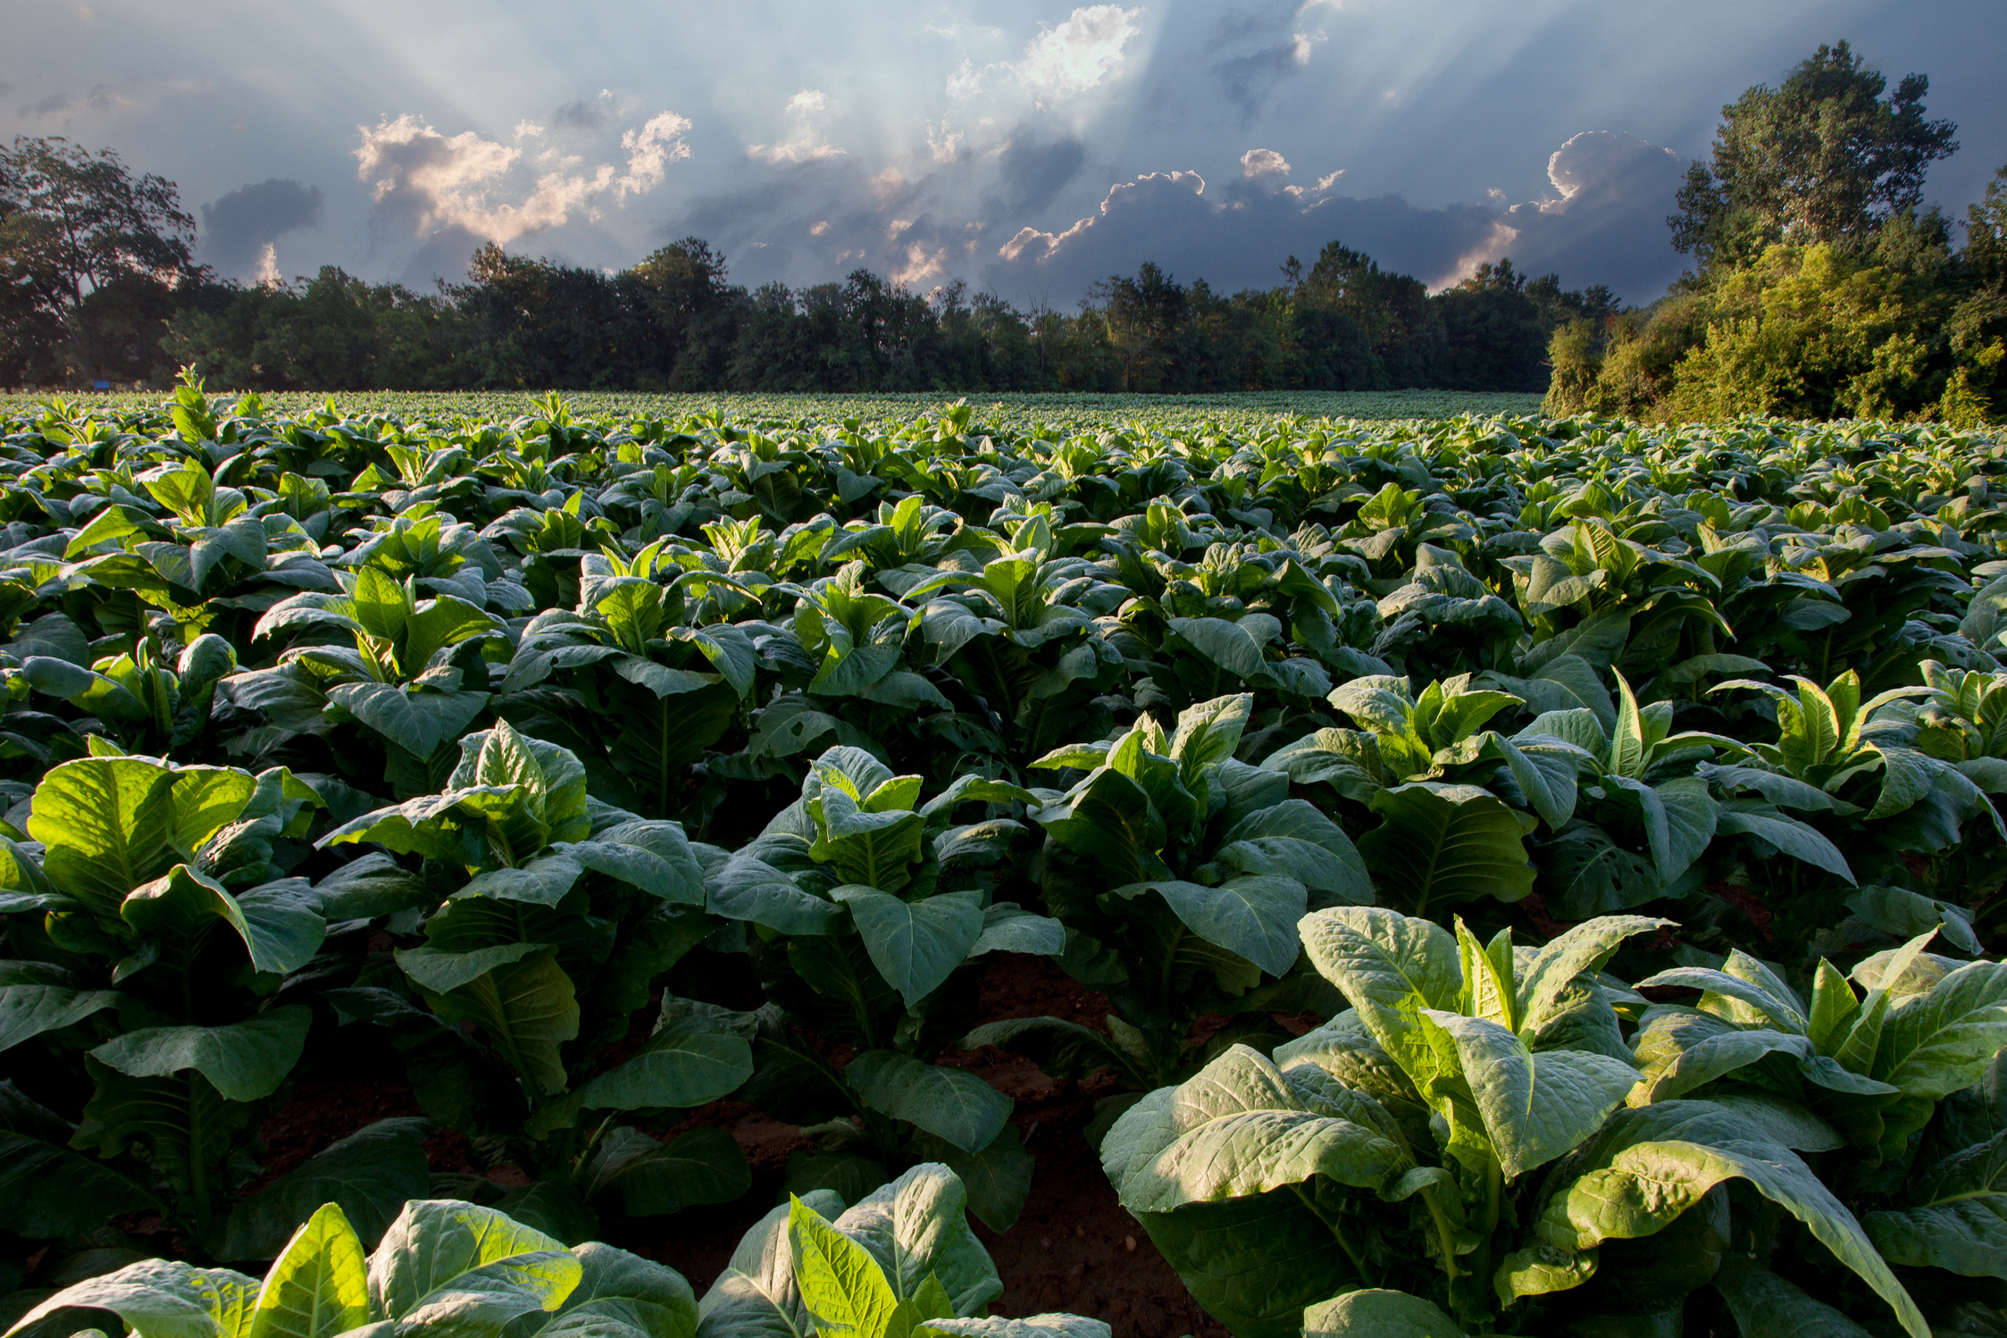


AUTOMATED INDOOR GARDEN
EE232 PRESENTATION
Planting the Future: Today’s Efforts, Tomorrow’s Harvest
Presented by
Group-4
GROW WISE SQUAD

Slide 2

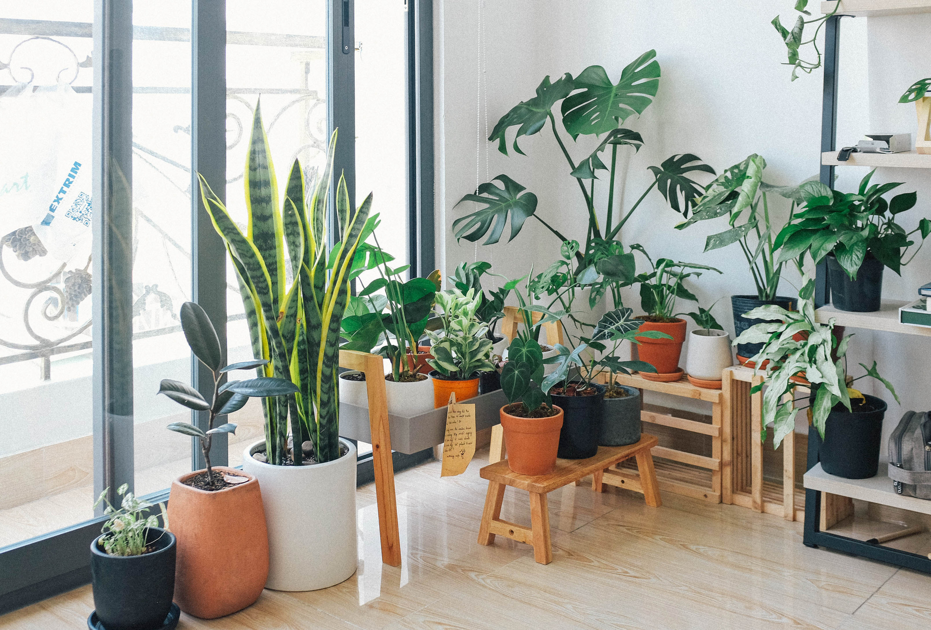

Introduction
Growing Goodness at Home:
Our project is all about making it easy for anyone to grow their own fresh food indoors. We're using smart technology to take care of the plants, so you don't have to worry about a green thumb. Our goal is to bring nature into your home, making it simple, efficient, and fun for everyone to enjoy homegrown goodness.

Slide 3
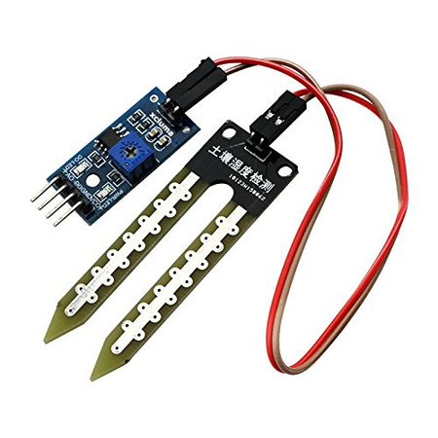
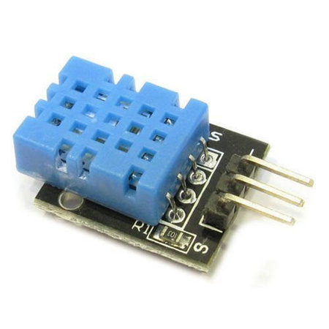
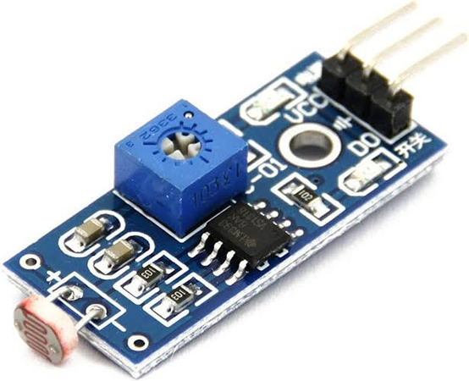

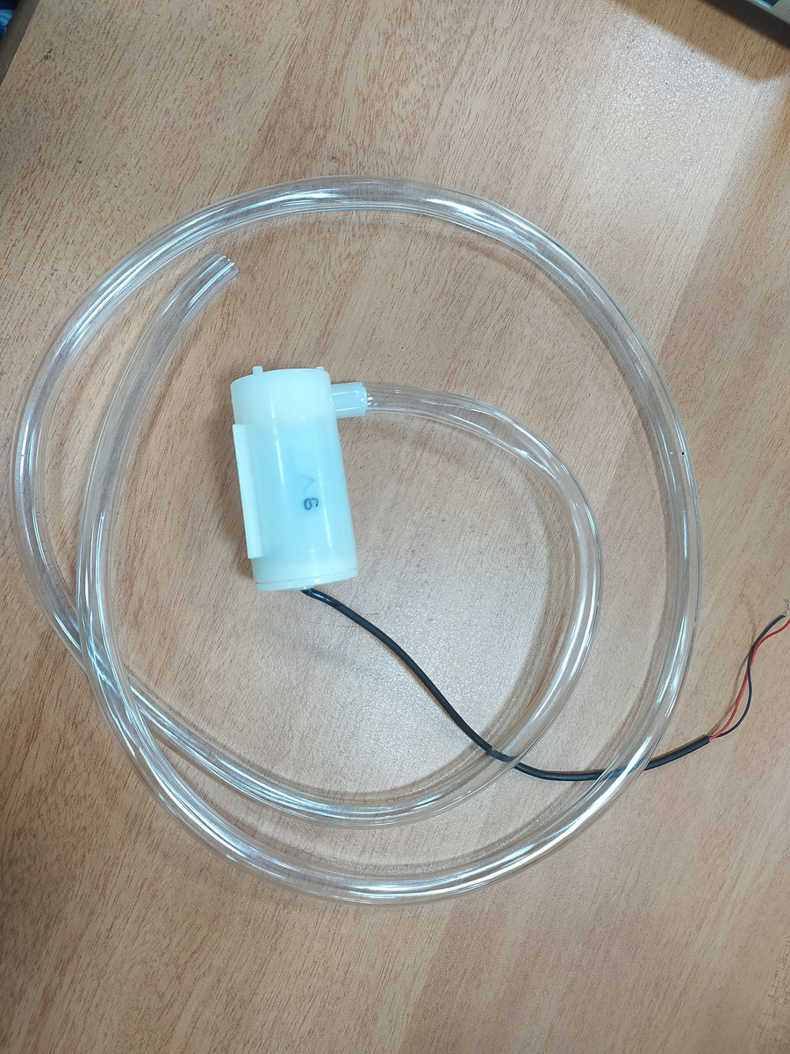
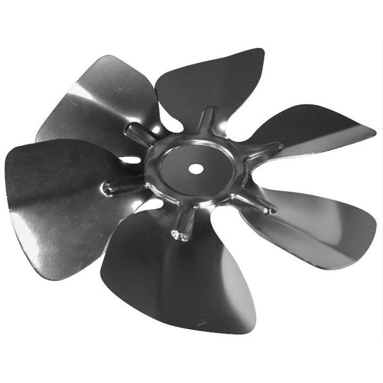
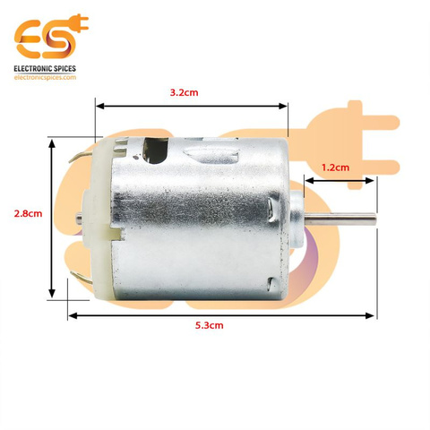
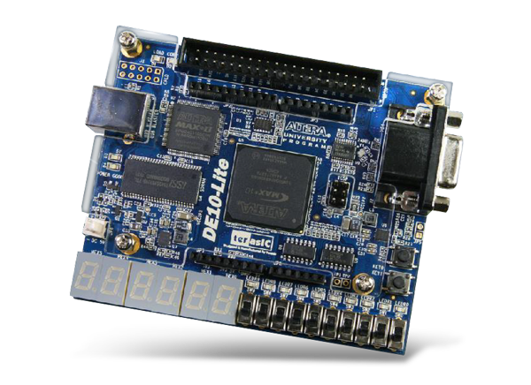
MOISTURE SENSOR
TEMPERATURE SENSOR
LIGHT SENSOR
ARDUINO UNO
SENSORS AND HARDWARE COMPONENTS
WATER PUMP
FAN
MOTOR
DE 10 LITE BOARD

Slide 4
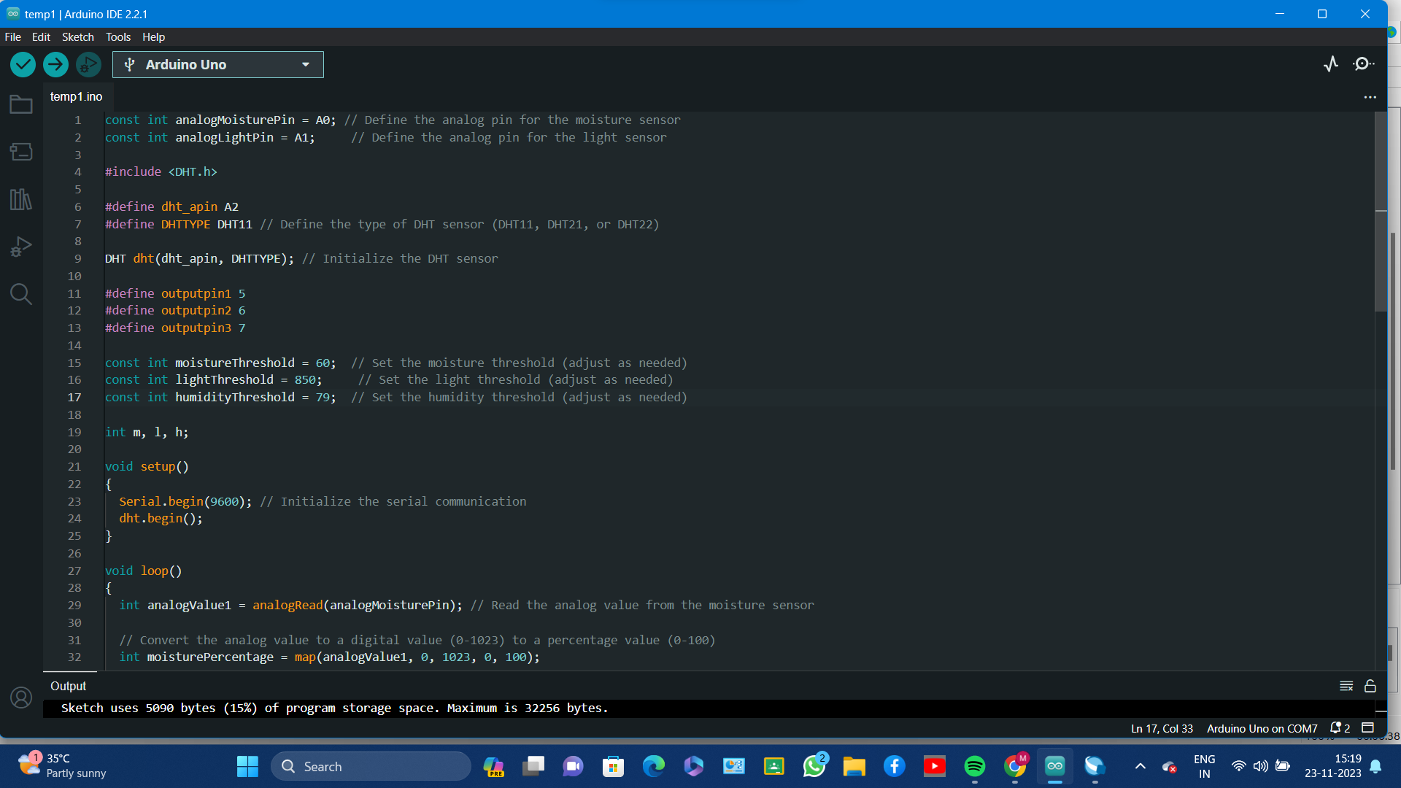
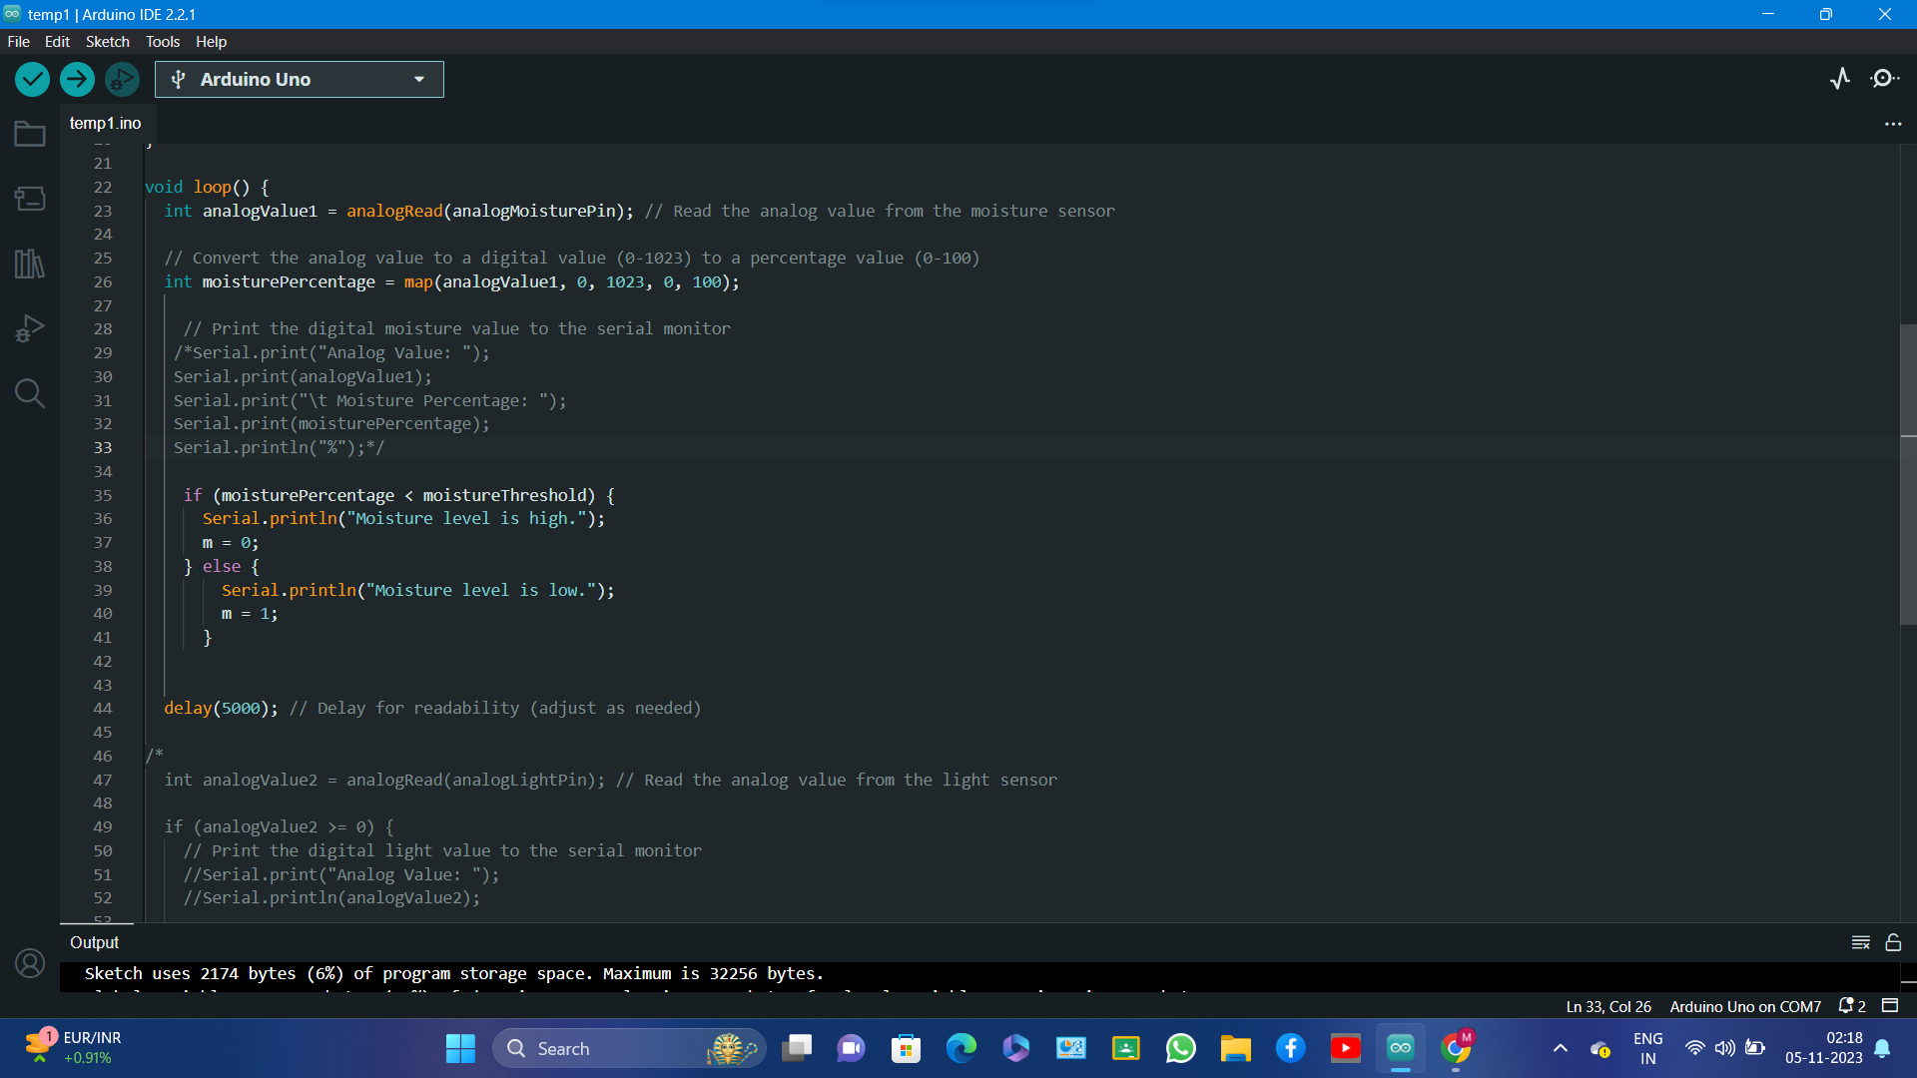

Slide 6
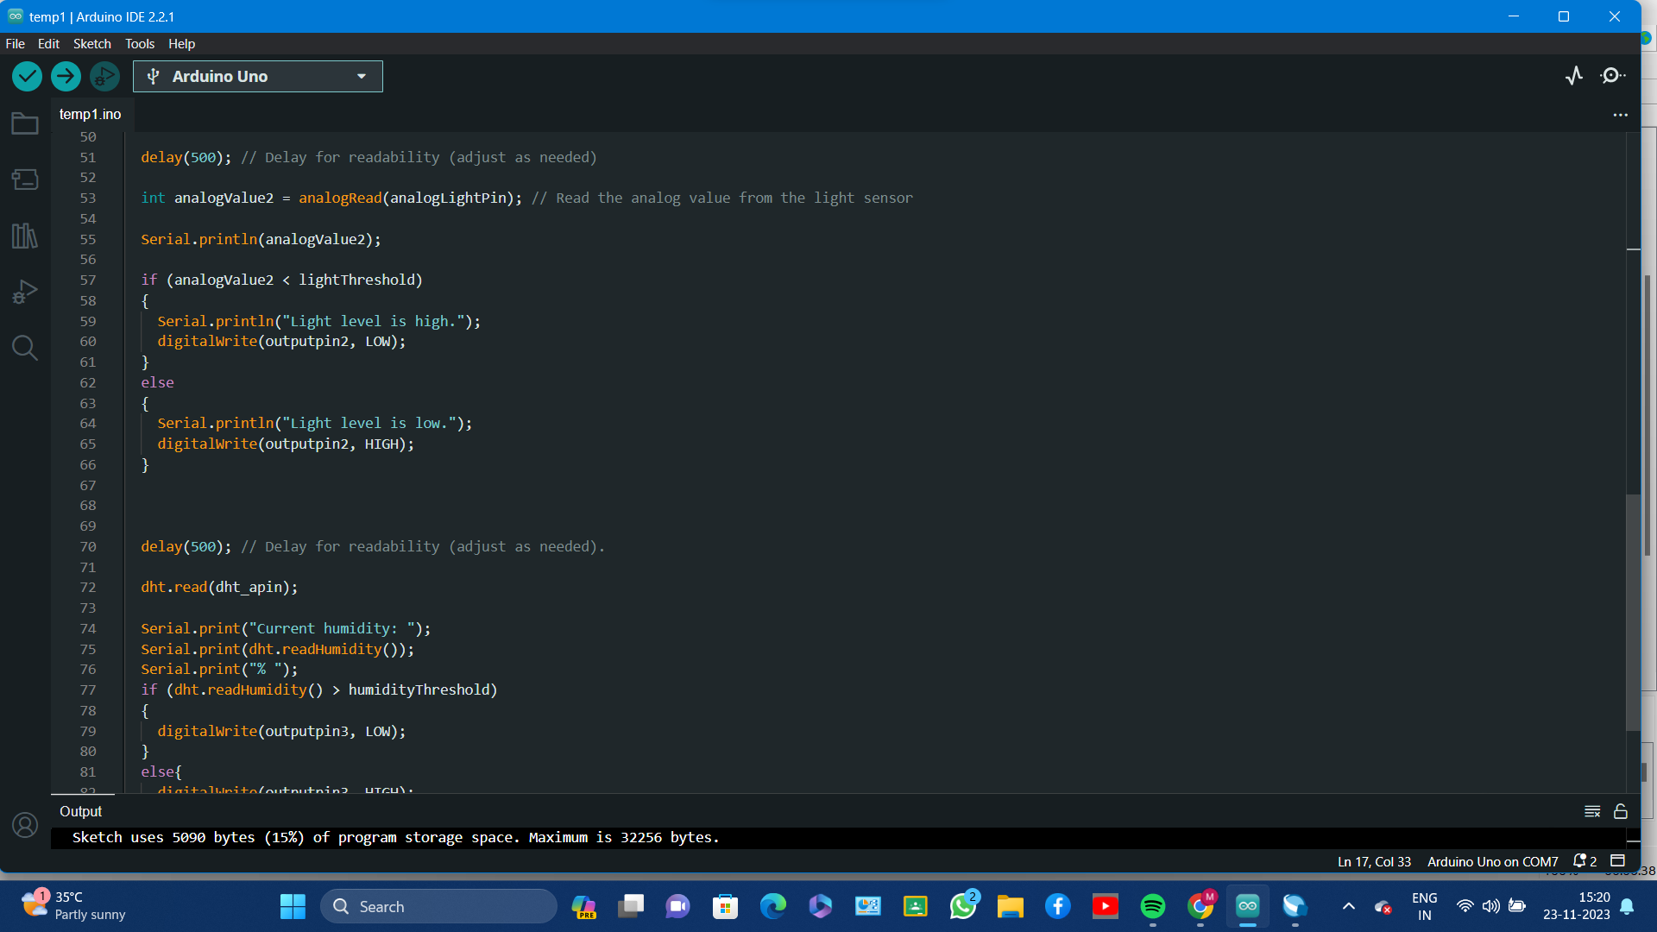
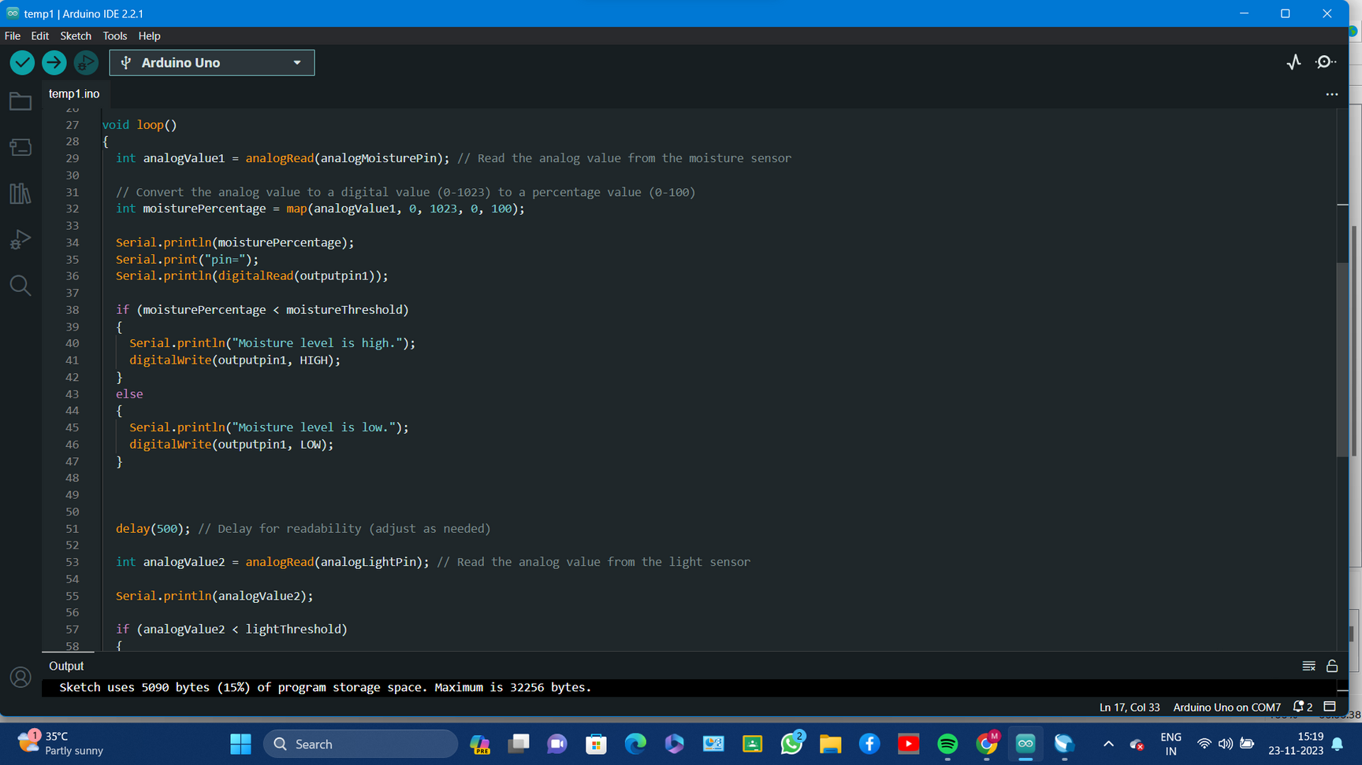

Slide 7
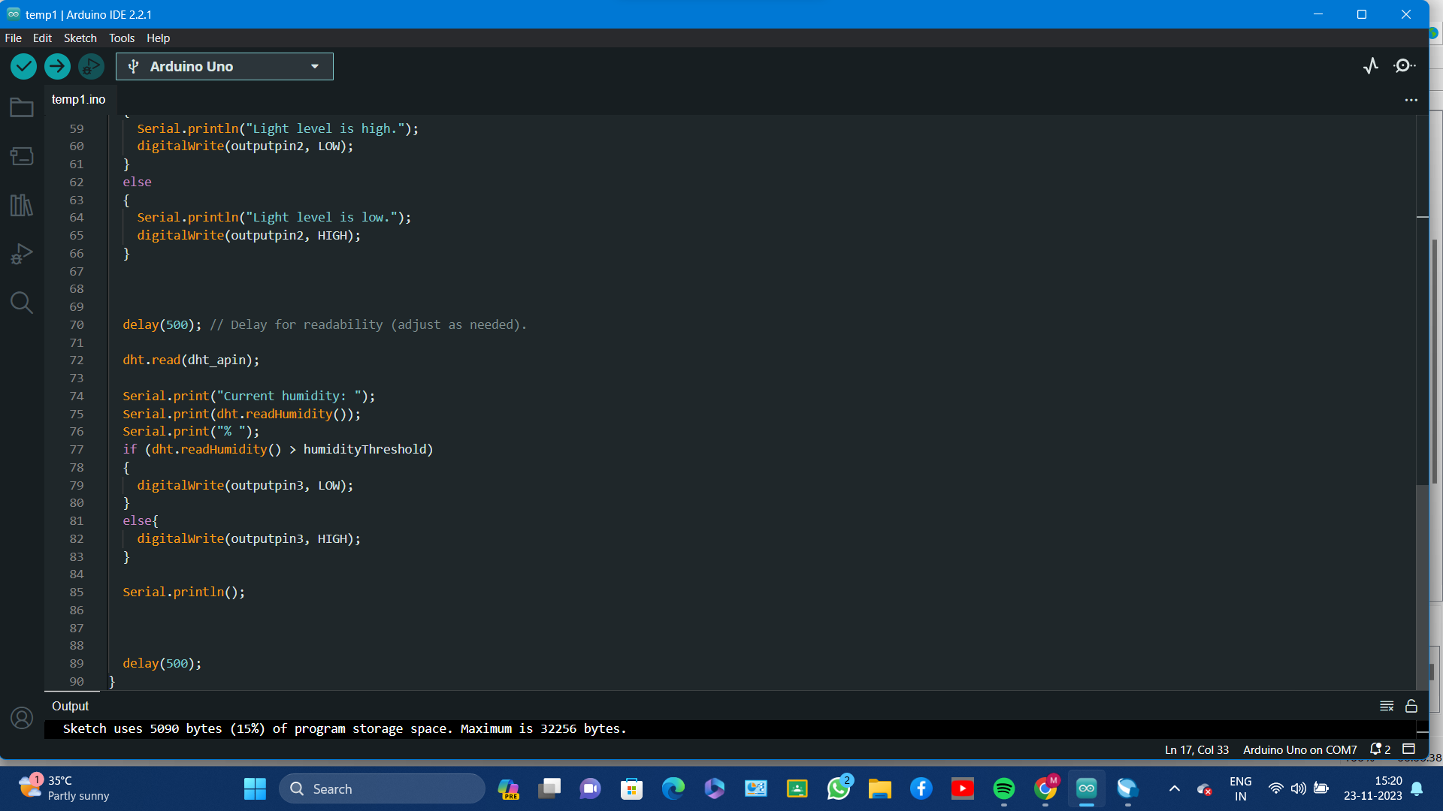

Slide 8
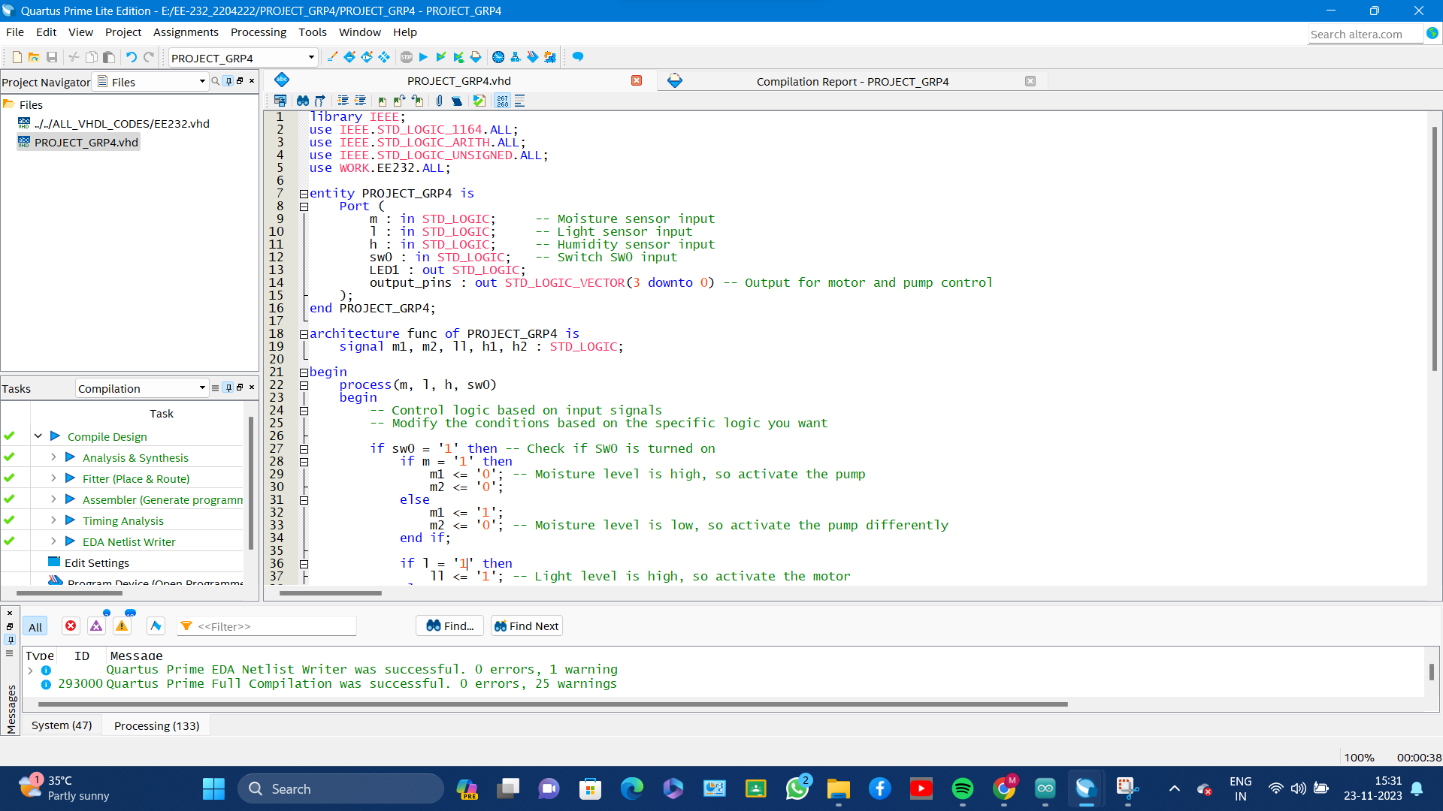
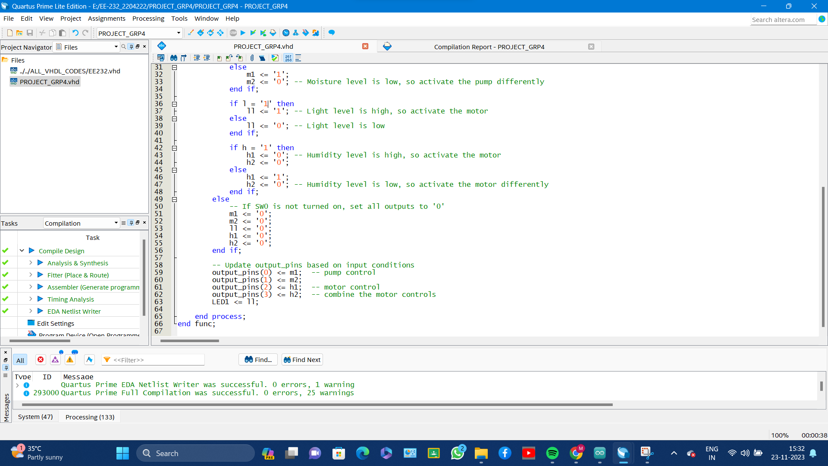

Slide 10
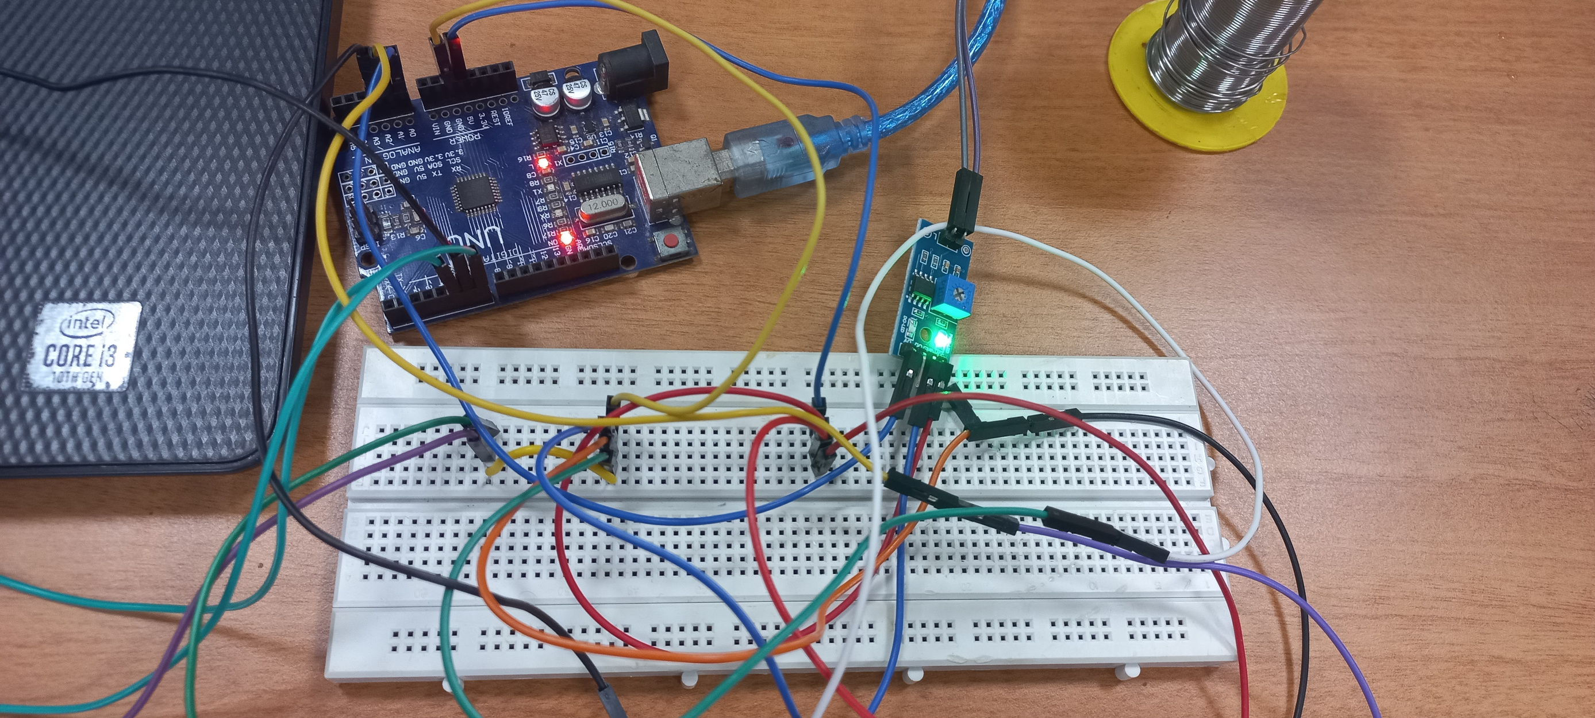

Slide 11
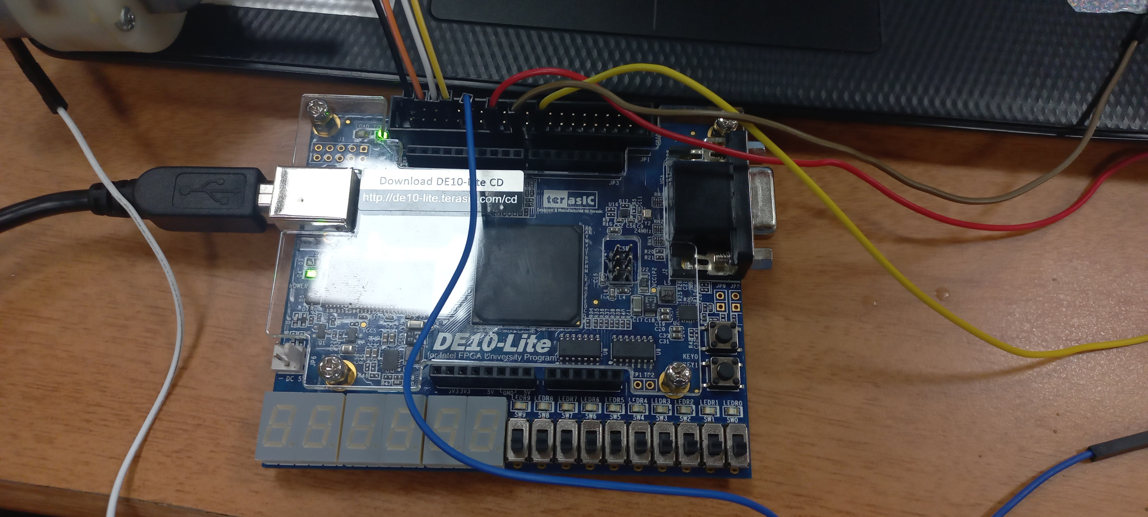

Slide 12
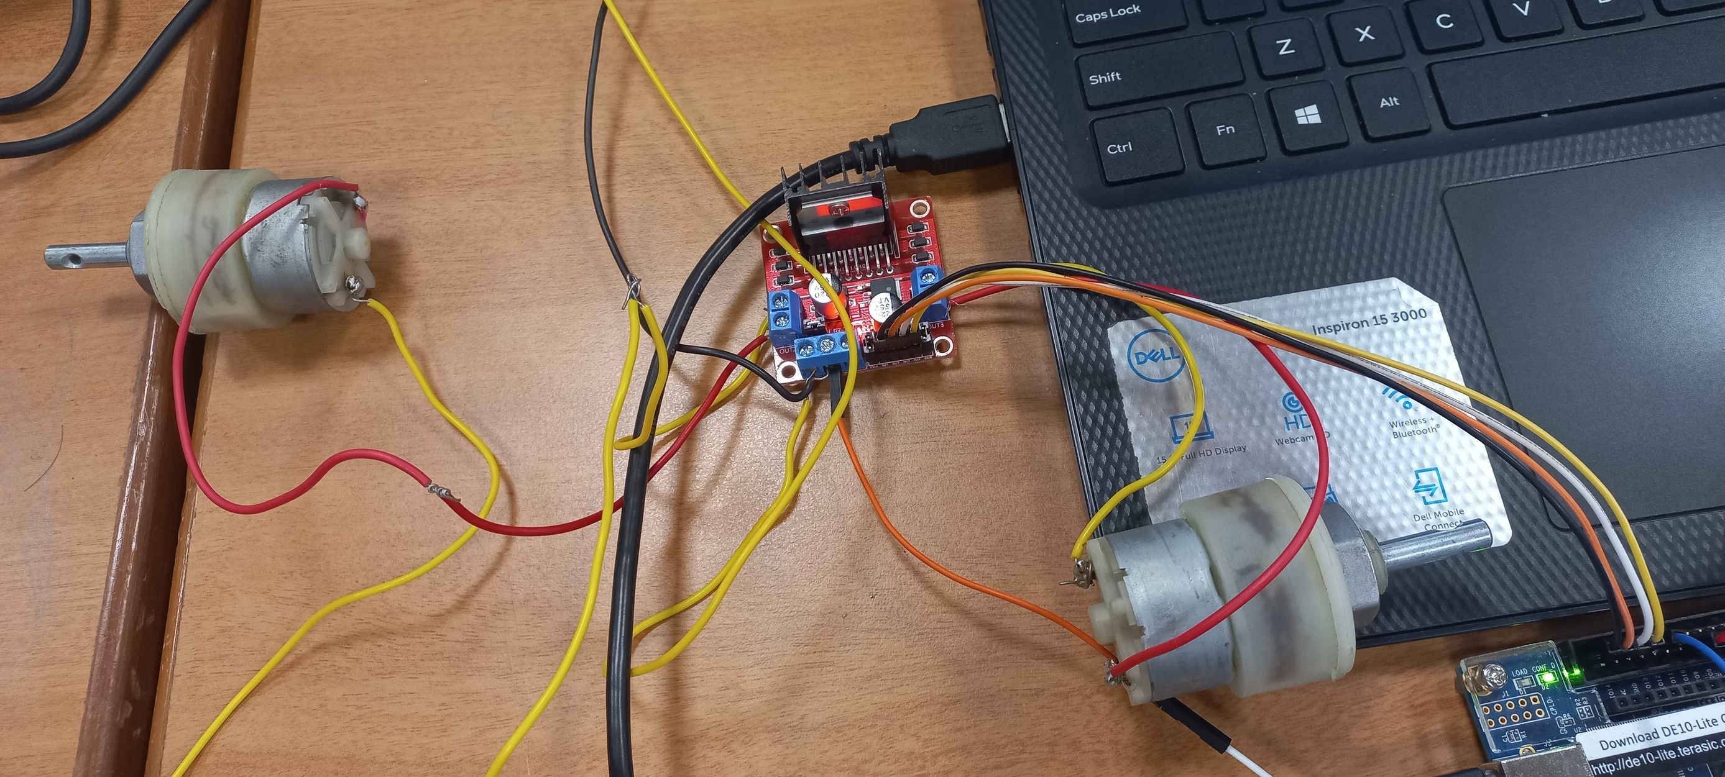

Slide 13




Future Outlook
FUTURE GOALS
In the future, we plan to integrate Bluetooth sensors for seamless communication within the indoor garden system. This will pave the way for a user-friendly mobile app, allowing remote control over environmental factors like humidity and lighting, enhancing accessibility and precision in managing the indoor garden environment.

Slide 14
THANK YOU

